Slide 1
DESIGN REVIEW 2
SAE Aero
Team
Team 508:
David Jay Michael Nalovic Sofia Rodriguez Tristan Wahl

Slide 2
DESIGN REVIEW 2
SAE Aero
Team
Team 508:
David Jay Michael Nalovic Sofia Rodriguez Tristan Wahl

Slide 3
Meet Team 508
David Jay
Manufacturing Engineer
Michael Nalovic
Controls Engineer
Sofia Rodriguez
Aeronautics Engineer
Tristan Wahl
Flight Design Engineer
Tristan Wahl

Slide 4
Sponsors and Advisor
Florida Space Grant Consortium
Dr. Yousuf Ali
Teaching Faculty II
Seminole RC Club
Tristan Wahl
Notes:
FSGC – Volunteer organization that assists with aerospace research funding in the state of Florida
Dr. Ali – Professor here at the FAMU-FSU COE with a primary focus in thermal fluids. He will be assisting us with the engineering analysis of our designs
Seminole RC – a local RC club that is providing our group with materials and practical knowledge of RC planes

Slide 5
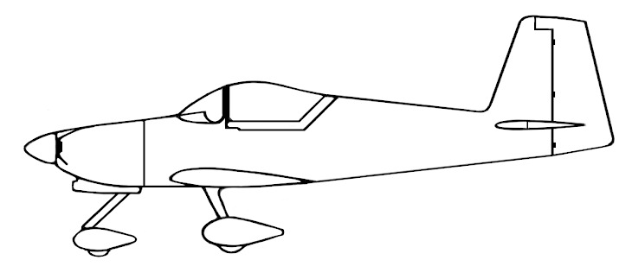
Project Objective
Design and manufacture an airplane to compete in the SAE Aero Design Competition.
Aircraft must be capable of carrying a size 5 soccer ball and taking off within 100ft
Our team will be concerned with the aerodynamics of the airplane
Team 507 will be focused on fuselage design
Tristan Wahl

Slide 6
Mission Profile
0. Mission starts with payload on board
1. Takeoff in less than 100ft
4
2. Ascend to safe cruise altitude
3
3. After traveling 400ft, turn back toward runway
5
2
6
0
1
4.Reorient for landing approach
5. Land on the same runway
6. Unload payload in under 1 minute
Tristan Wahl
Notes:
This is the mission profile as interpreted from the SAE guidelines

Slide 7
Key Goals
Adhere to Competition Guidelines
Design Wing and Tail Section
Aerodynamic Analysis
Manufacture and Test
David Jay
Notes:
The first key goal that our team defined is to adhere to the SAE competition guidelines. These guidelines dictate the mission profile, material selection, and general design requirements.
Our group will be specifically focusing on the aerodynamics of the airplane, so our next goal is to design the wing and tail section.
Next, we will need to perform an aerodynamic analysis of the plane.
Finally, we will need to manufacture and test our wing/tail sections.

Slide 8
Customer Needs
01
02
03
AHERE TO SAE
GUIDELINES
3D PRINTED
PLANE
INNOVATION
Follow SAE competition rules and restrictions
Create a new and different design
Majority of the plane must be made of 3D printed material
David Jay
Notes:
Our primary customer for this project is our Senior Design Professor, Dr. McConomy. He gave us 3 primary needs:
-of course we need to comply with SAE competition guidelines
-We need to be innovative in some way or another. Incorporating new ideas wherever possible
-Finally, Dr. McConomy has specified that our plane must be 3D printed. This means that the majority of structural components must be 3D printed.

Slide 9
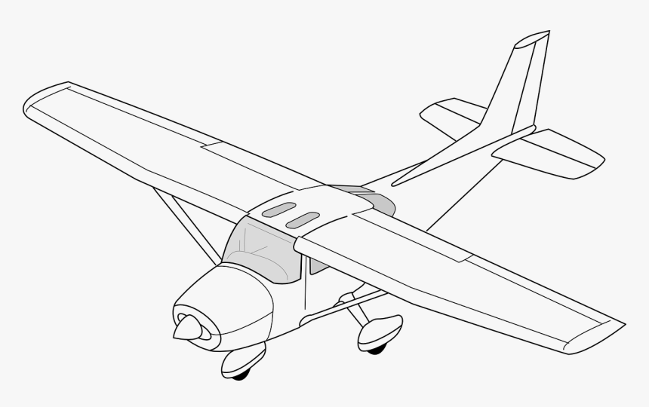
Airplane Controls Explained
1
Ailerons – Control Roll
2
Elevator – Controls Pitch
3
Throttle – Controls Motor Thrust
4
Rudder – Controls Yaw
5
Flaps – Increase Lift and Drag
David Jay
Notes:
Typically, full scale aircraft almost always feature all 5 of these controls.
RC aircraft generally have at least the first 4, HOWEVER, some configurations can get away with only 3.

Slide 10
Major Functions
Takeoff
Landing
Carry Payload
Flight Controls
David Jay
Notes:
Our aircraft will have 4 primary functions:
First it will need to take off
It will need to be able to carry a payload
The pilot will need to be able to control the plane to follow the mission profile
Finally, the airplane needs to land safely on the runway
Although our team is primarily focused on the aerodynamics, there are very few factors that do not affect the aerodynamics of the plane, so we need to consider the major functions of the fuselage as well.

Slide 11
Targets and Metrics
Takeoff
Flight Control
Metric
Metric
Metric
Takeoff Distance
Thrust Force
Wing Area
Metric
Metric
Metric
Control Surface Deflection
Rise Time of Motor Speed
Static Margin
Less than 100ft
Greater than 10lbs
Greater than 6 ft
At least 25°
4 seconds
5%– 15%
Target
Target
Target
Target
Target
Target
2
David Jay
Notes:
Our team allowed the fuselage group to determine their own targets and metrics for the payload and landing gear, while we focused more on takeoff and controlling the plane. Here we have displayed some of the most important metrics that contribute to the aerodynamic success of the airplane.
Our takeoff distance was predefined by the competition guidelines. Using this metric, we made some initial estimates to calculated a required thrust force for the plane based on a wing with a 6ft^2 planform area. The only reason a minimum planform area is defined as a metric is because our calculations all began with that minimum assumption.
For control, the first metric we placed was a minimum control surface deflection. Typically control surfaces lose effectiveness past 20deg, so we design for a larger deflection that can be turned down on the transmitter. In addition, we also require that the motor selected has a minimum rise time of 4 seconds. This will ensure that the pilot has ample throttle control to get out of potentially dangerous situations. Finally, we have set a target for the static margin of the airplane. The static margin is an indicator of the airplanes pitch stability and should be between 5% and 15%

Slide 12
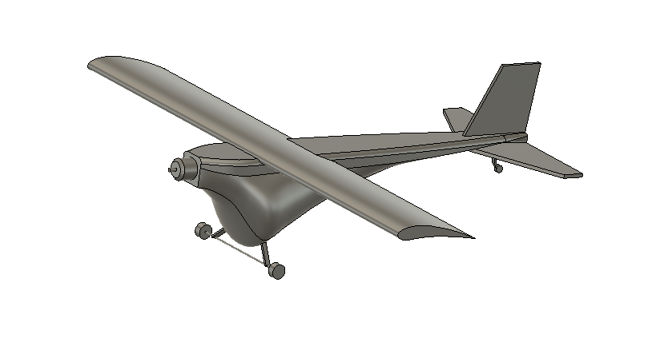
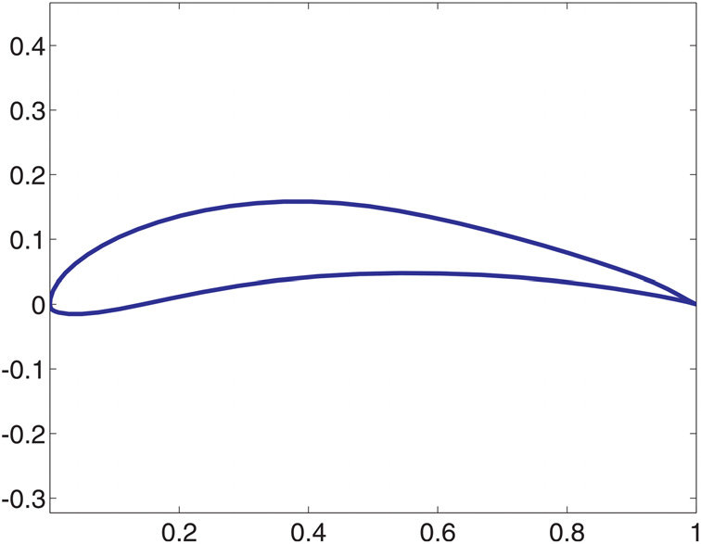
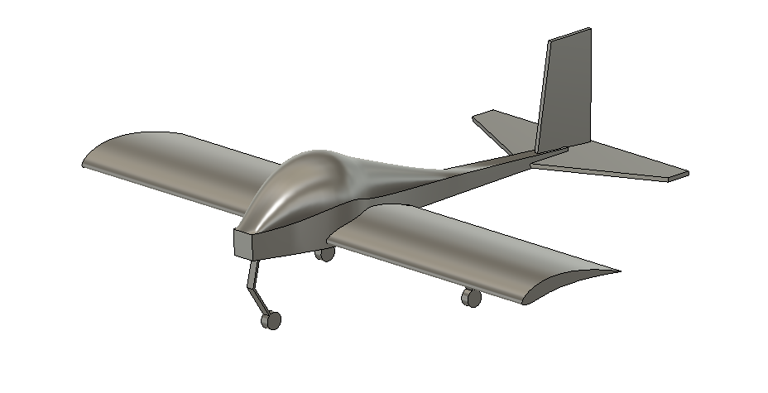
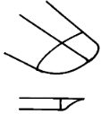
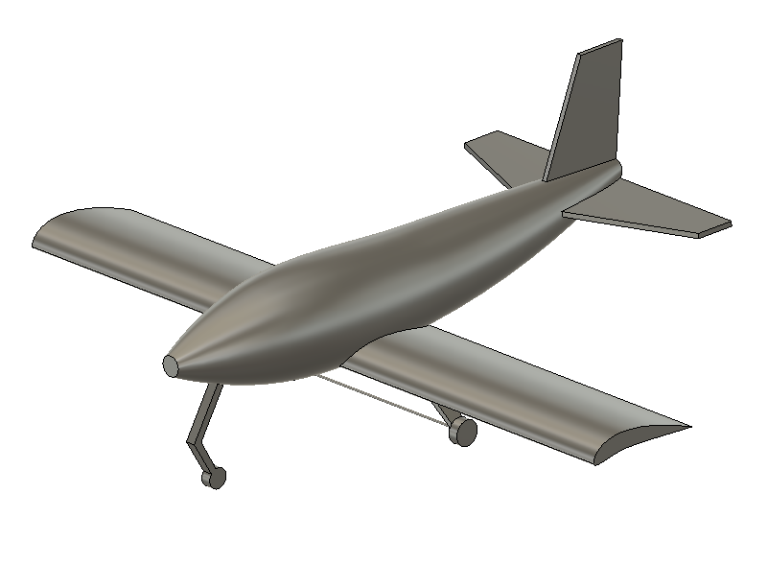
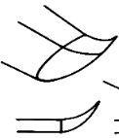
Concept Generation
Fuselage Type
Airfoil
Wing Placement
Landing Gear
Tail
Wing Tips
"Guppy"
High Wing
Standard
Cutoff
E-423
Tricycle
"Dolphin"
Mid Wing
T-Tail
Hoerner
S-1223
Tail Dragger
Low Wing
V-Tail
Upswept
"Whale"
Tristan Wahl
Notes:
In order to come up with multiple concept ideas, we started with a morphological chart with our initial design ideas.
We decided the 3 fuselage concepts from our prototypes, the airfoils from their data and earlier research, the wing placements and their various tradeoffs, the 2 landing gear setups, types of tails and eventually wingtips to help with our innovation requirement
http://www.zenithair.com/stolch801/design/design.html

Slide 13
High Fidelity Concepts
Guppy
Dolphin
Whale
Tristan Wahl

Slide 14
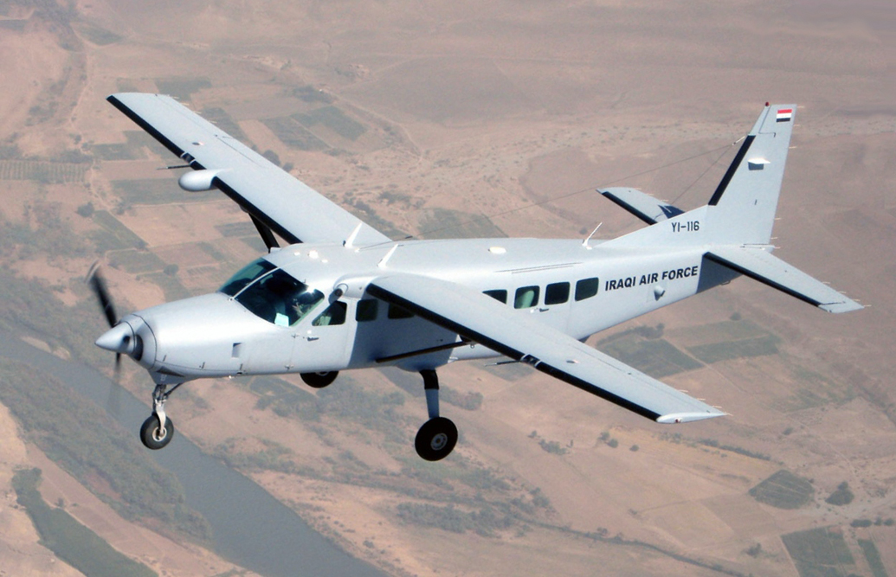
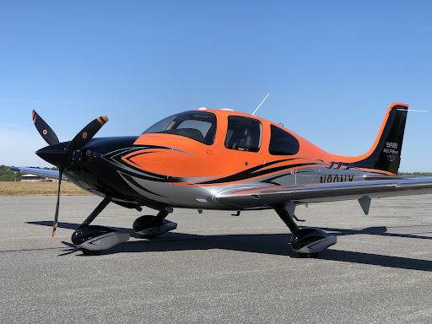
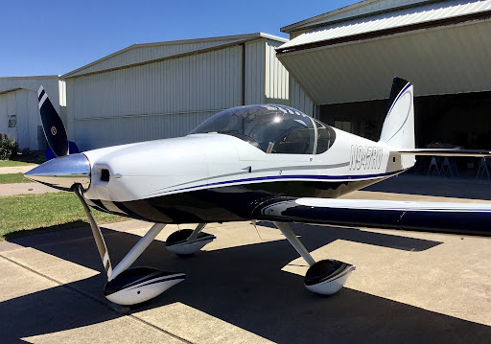
Medium Fidelity Concepts
Concept 1
Air Tractor AT-502B
Concept 2
Cessna 208B
Concept 3
Cirrus SR-22
Concept 4
Vans Aircraft RV-14
Fig.1 Air Tractor
Fig. 2 Cessna 208B
Fig. 3 Cirrus SR-22
Fig. 4 Vans Aircraft RV-14
Tristan Wahl
Notes:
Talking Points: Wing Placement, Fuselage design, Landing Gear Configuration. They all meet certain criteria of our morphological chart and would be easier to scale down a version than to create an altogether original design. We list them as medium fidelity concepts because scaling down an existing design is not very innovative
Reference: https://www.texascooppower.com/texas-stories/life-arts/the-building-of-a-bird
https://en.wikipedia.org/wiki/Cessna_208_Caravan

Slide 15
Concept Selection
Customer Needs
Comply with SAE guidelines
Engineering Characteristics
Weight
Control Surface Deflection
Static Margin
Thrust Force
Resistance to stress
Innovate
3D Printed
Customer needs were broken down into engineering characteristics
Importance weight factor calculated for each engineering characteristic to determine which are most vital to success
David Jay
Notes:
Most of our engineering characteristics come from the SAE competition guidelines. 5 of the most important engineering characteristics are listed here.
We want to:
-Decrease Weight
-Constrain control surface deflection
-Constrain static margin
-Increase Thrust force
-Increase resistance to stress (make sure the plane doesn’t break under loading)

Slide 16
Concept Selection
Alternative Values Calculated from Selection Process
0.524
Cirrus SR-22
0.476
Vans Aircraft RV-14
David Jay
Notes:
After going through multiple iterations of the concept selection process, we narrowed it down to two candidates. In the end, the Cirrus SR-22 won by a small margin against the Vans RV-14. Both concepts are extremely similar, which makes sense why they are so close in selection values.
One thing to note is that concept selection for an entire airplane is not a trivial task. Almost every decision affects the aerodynamics of the plane and there are thousands of decisions that could be made. Our team used this concept selection process to decide on a final layout of the plane rather than specific details. In addition, nothing scales perfectly, so it’s very likely that our final design differs as we iterate and reanalyze.
If we were to do this project again, we may consider doing a concept selection process for each aspect of the plane, rather than the entire design.

Slide 17
"Final" Concept
"Whale" Fuselage design
Eppler 423 Airfoil
Low Wing
Tail Dragger Landing Gear
Conventional Tail
Hoerner Wing Tips
David Jay
Notes:
Although our concept selection process deemed the SR-22 best for our project, this design lacked in the major aspect of innovation. For the "Final" concept our team will be moving forward with, we decided to use the general layout of the SR-22 design with a new, more innovative fuselage that is better suited for our application.

Slide 18
Future Work
Detailed Design of Wing and Tail
Final Aerodynamic Validation
Manipulate Designs for Manufacturing
Structural Analysis of Wing and Tail
Manufacturing and Testing
David Jay
Notes:
The next step for our team is to finish the detailed design of our wing
Control linkages
Servo placement
Spar placement
Many of our design decisions have been based on aerodynamic calculations, once we finish our detailed design, we will be performing a final aerodynamic validation of the plane.
Next, we will be slicing the models into chunks that can be 3D printed and attached together
The last step before we begin printing is to do a structural analysis to ensure that the wings will not sag or fold under load
And finally, starting next semester, we will begin the manufacturing and testing process.

Slide 19
References
Dr. McConomy, S. (2021). Customer Needs.
“2022 SAE Aero Design Rules.” SAE Aero Design, www.saeaerodesign.com/cdsweb/gen/DocumentResources.aspx.
Aerodynamic on the noun project. The Noun Project. (n.d.). Retrieved November 12, 2021, from https://thenounproject.com/term/aerodynamic/.
The building of a Bird. Texas Co-op Power Magazine. (n.d.). Retrieved November 12, 2021, from https://www.texascooppower.com/texas-stories/life-arts/the-building-of-a-bird.
McGettrick Structural Engineering - Home. (n.d.). Retrieved November 12, 2021, from http://www.mcgettrickengineering.com/.
Raymer, D. P. (1992). Aircraft design: A conceptual approach.
Wikimedia Foundation. (2021, August 28). Cessna 208 Caravan. Wikipedia. Retrieved November 12, 2021, from https://en.wikipedia.org/wiki/Cessna_208_Caravan.
David Jay

Slide 20
Backup Slides

Slide 21
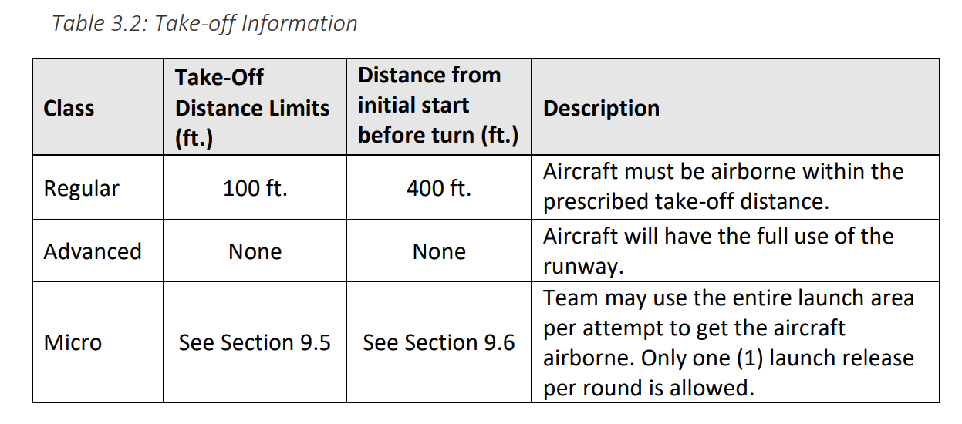
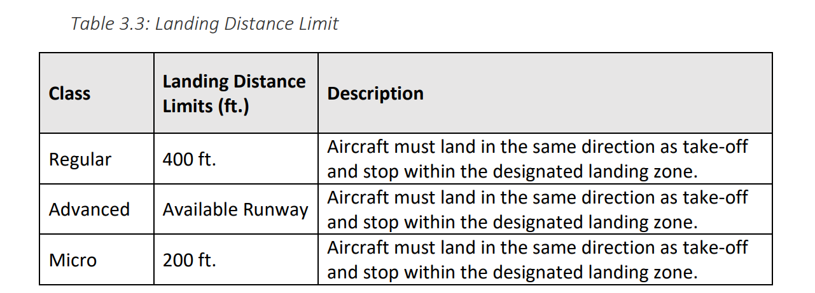
SAE Guidelines

Slide 22
Lift/Velocity Estimations
Thrust Force (Ft)
Drag Force $(Fd=\frac{1}{2}C_{D}ρv^{2}A)$
$$x$$
$$v$$
Equations of Motion:
$m\ddot{x}=Ft − \frac{1}{2}C_{D,w}ρ{\dot{x}}^{2}A_{w}$ $− \frac{1}{2}C_{D,f}ρ{\dot{x}}^{2}A_{f}$

Slide 23
WAVE'S END SWIMWEAR
5-Step Ordering Process
1
2
3
4
5
Add items
to cart
Add
promos
Proceed to checkout
Put your shipping details
Place
order!

Slide 24
Embodiment
Upcoming Presenter’s Name

Slide 26
Manufacturing
Upcoming Presenter’s Name

Slide 28
Testing
Upcoming Presenter’s Name

Slide 30
Project Management

Slide 32
# Most Important Points
The quick brown fox jumps over the lazy dog.
The quick brown fox jumps over the lazy dog.
The quick brown fox jumps over the lazy dog.
The quick brown fox jumps over the lazy dog.
The quick brown fox jumps over the lazy dog.
The quick brown fox jumps over the lazy dog.

Slide 33
Lessons Learned
Don’t make these start earlier test earlier and so on.

Slide 34
Reference

Slide 35
Questions (be sure to design your own)

Slide 36
Backup Slides

Slide 39
College of Engineering Color Palette
2299 C
Color Values:
RGB 164 210 51
Hex/HTML #A4D233
CMYK 41 0 84 0
1788 C
Color Values:
RGB 238 39 55
Hex/HTML #EE2737
CMYK 0 88 82 0
75% Black
Color Values:
RGB 64 64 64
Hex/HTML #404040
CMYK 0 0 0 75
Pantone
2299 C
Pantone
1788 C
CoE Dk Gray
2239 C
Color Values:
RGB 0 207 180
Hex/HTML #00CFB4
CMYK 59 0 39 0
647 C
Color Values:
RGB 35 97 146
Hex/HTML #236192
CMYK 96 54 5 27
50% Black
Color Values:
RGB 128 128 128
Hex/HTML #808080
CMYK 0 0 0 50
Pantone
2239 C
Pantone
647 C
CoE Md Gray
2199 C
Color Values:
RGB 0 187 220
Hex/HTML #00BBDC
CMYK 77 0 16 0
7535 C
Color Values:
RGB 183 176 156
Hex/HTML #B7B09C
CMYK 10 11 23 19
25% Black
Color Values:
RGB 191 191 191
Hex/HTML #bfbfbf
CMYK 0 0 0 25
Pantone
2199 C
Pantone
7535 C
CoE Lt Gray
Notes:
Theses are the official color palettes of the college of engineering.

Slide 40
PowerPoint Color Theme
Accent1
647 C
Color Values:
RGB 35 97 146
Hex/HTML #236192
CMYK 96 54 5 27
Accent4
2239 C
Color Values:
RGB 0 207 180
Hex/HTML #00CFB4
CMYK 59 0 39 0
Light 1
White
Color Values:
RGB 255 255 255
Hex/HTML #FFFFFF
CMYK 0 0 0 0
Dark 1
100% Black
Color Values:
RGB 0 0 0
Hex/HTML #000000
CMYK 0 0 0 100
Pantone
647 C
Pantone
2239 C
White
Black
Accent 2
2199 C
Color Values:
RGB 0 187 220
Hex/HTML #00BBDC
CMYK 77 0 16 0
Accent5
7535 C
Color Values:
RGB 183 176 156
Hex/HTML #B7B09C
CMYK 10 11 23 19
Light 2
25% Black
Color Values:
RGB 191 191 191
Hex/HTML #bfbfbf
CMYK 0 0 0 25
Dark 2
75 % Black
Color Values:
RGB 64 64 64
Hex/HTML #404040
CMYK 0 0 0 75
Pantone
2199 C
Pantone
7535 C
CoE Lt Gray
CoE Dk Gray
Accent3
1788 C
Color Values:
RGB 238 39 55
Hex/HTML #EE2737
CMYK 0 88 82 0
Accent6
2299 C
Color Values:
RGB 164 210 51
Hex/HTML #A4D233
CMYK 41 0 84 0
Pantone
1788 C
Pantone
2299 C
Notes:
These are the college colors as prioritized within this PowerPoint Template

Slide 41
FINANCIAL PLANNING CYCLE
Zenith Central Bank
Stage 1
Stage 2
Stage 3
Stage 4
Stage 5
Stage 6
Understand your
needs and goals
Assess your current
financial state
Create funds essential to
your survival
Follow a schedule of budgeting
and stick to it
Monitor
Refine as needed

Slide 42
Social Media
Packages
Bronze
10 posts,
captions &
graphics
Silver
20 posts,
captions &
graphics
Gold
30 posts,
captions &
graphics
550
750
850

Slide 43
FINANCIAL PLANNING CYCLE
Zenith Central Bank
Stage 1
Understand your needs and goals
Stage 2
Assess your current financial state
Stage 3
Create funds essential to your survival
Stage 4
Follow a schedule of budgeting and stick to it
Stage 5
Monitor
Stage 6
Refine as needed

Slide 44
TEAM 508 COLORS
Accent1
647 C
Color Values:
RGB 35 97 146
Hex/HTML #236192
CMYK 96 54 5 27
Accent4
2239 C
Color Values:
RGB 0 207 180
Hex/HTML #00CFB4
CMYK 59 0 39 0
Light 1
White
Color Values:
RGB 255 255 255
Hex/HTML #FFFFFF
CMYK 0 0 0 0
Dark 1
100% Black
Color Values:
RGB 0 0 0
Hex/HTML #000000
CMYK 0 0 0 100
Pantone
647 C
Pantone
2239 C
White
Black
Accent 2
2199 C
Color Values:
RGB 0 187 220
Hex/HTML #00BBDC
CMYK 77 0 16 0
Accent5
7535 C
Color Values:
RGB 183 176 156
Hex/HTML #B7B09C
CMYK 10 11 23 19
Light 2
25% Black
Color Values:
RGB 191 191 191
Hex/HTML #bfbfbf
CMYK 0 0 0 25
Dark 2
75 % Black
Color Values:
RGB 64 64 64
Hex/HTML #404040
CMYK 0 0 0 75
Pantone
2199 C
Pantone
7535 C
CoE Lt Gray
CoE Dk Gray
Accent3
1788 C
Color Values:
RGB 238 39 55
Hex/HTML #EE2737
CMYK 0 88 82 0
Accent6
2299 C
Color Values:
RGB 164 210 51
Hex/HTML #A4D233
CMYK 41 0 84 0
Pantone
1788 C
Pantone
2299 C
Notes:
These are the college colors as prioritized within this PowerPoint Template

Slide 45
Notes:
This slide has the rule of third layout tool. The rule thirds layout helps with the sizing of elements.

Slide 46
Notes:
This slide has the rule of third layout tool. The rule thirds layout helps with the sizing of elements.

